Slide 1
Pelvis & Lower Body
Yogis In Service 200-Hr YTT 2021
Marissa Bland, OTR/L, E-RYT 200

Slide 2
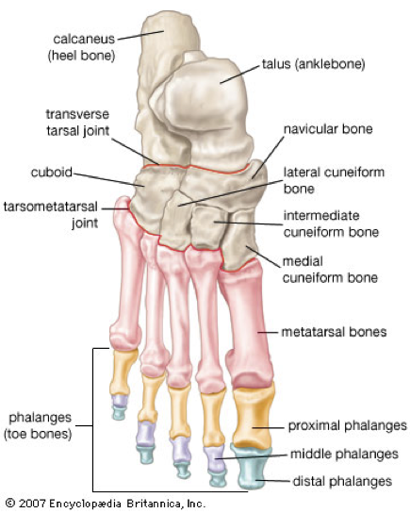
The Foot
26 small bones:
14 phalanges
5 metatarsal bones
7 tarsal bones

Slide 3
“Big Toe Mound”
& Arches of the Foot
2 Sesamoid bones
Notes:
Image found at: https://images.app.goo.gl/YKw1wF6VBZpXW9Jy5 & https://annwestyoga.com/wp-content/uploads/2017/02/three-foot-arches.jpg

Slide 4
Intrinsic Muscles of the Foot

Slide 5
Notes:
Retrieved fro,: https://acewebcontent.azureedge.net/expert-articles/2018/04/2018-04-05-How-strong-is-your-foot-01.jpg

Slide 6
Motions of the Foot/Ankle
Notes:
Retrieved from: https://i.pinimg.com/736x/79/a7/c9/79a7c99a7352ca14b149268c9812a9c8.jpg

Slide 7
Bones of the Lower Leg
Notes:
Retrieved from: https://encrypted-tbn0.gstatic.com/images?q=tbn:ANd9GcSwSQc6dA65FcNAKhE6SxKbvNeDVNkf7fK1Cg&usqp=CAU

Slide 8
The Knee
Femur (thigh bone) meets Tibia (shin bone)
Patella = “Knee Cap”
Direction of joint motions are reversed here: flexion & extension

Slide 9
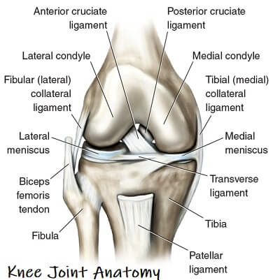
Ligaments of the Knee
ACL: prevents tibia from sliding in front of femur
MCL: Injured with force to outside of knee
LCL: Injured with force to inside of knee
Injuries during quick stops, changing direction, bending, twisting, jumping

Slide 10
Hyperextension
Causes injury to posterior knee ligaments
Usually due to weak/not fully engaged quads = “path of least resistance”
Need to strengthen quads & engage
Notes:
Retrieved from: https://images.ctfassets.net/p0sybd6jir6r/6OEtvB3E9FiD5KNZg4EcRq/96f41a520b8ac9db23387d4fc35de04b/Asana_Hyperextended_Knee-a3313af8a7482dd6755763c88ba8863e.jpg?w=1600&q=70

Slide 11
The Upper Leg/ Thigh

Slide 12
Muscles of the Upper Leg
“Quads”= Rectus Femoris & Vastus Lateralis/Medialis/Intermedius
“Hams”= Semitendinosus, Semimembranosus, & Biceps Femoris
“Inner thigh”= ADDuctors
“Outer thigh” & “hip”= ABDuctors
Notes:
https://i.pinimg.com/originals/97/7d/bf/977dbf3accc046e5f1875721800c3bf2.jpg

Slide 13
The Pelvis

Slide 14
Pelvis Ligaments

Slide 15
Pelvic Tilts

Slide 18
Groups of Muscles & Their Actions- Simplified!
Hip FLEXORS = Anterior Hip & Thigh!
Psoas (Major & Minor), Iliacus, Recuts Femoris (Quad)
Hip EXTENSORS= Posterior Hip & Thigh!
Hamstrings, Gluteus Maximus
Hip ABDUCTORS= Lateral Hip & Thigh!
Gluteus minimus, Gluetus medius, Sartorius, Piriformis and Tensor Fascia Latae (TFL)
Hip ADDUCTORS= Medial Hip & Thigh!
Pectineus, Adductor Longus, Gracilis Adductor Brevis, Adductor Magnus

Slide 19
Hip Flexors
Tight hamstrings restrict forward folds!
Notes:
https://antranik.org/wp-content/uploads/2014/05/front-scale-antranik.jpg ; https://www.yogauonline.com/sites/default/files/styles/wellness_blog_level3_main/public/article_images/navasana_3_yoga_variations_for_practicing_boat_pose.png?itok=vaoCOxMY ; https://www.yoganatomy.com/wp-content/uploads/2017/07/standing-forward-bend-hasta.jpg

Slide 20
Hip Extensors
Tight hip flexors are often what limits backbends & causes compression in low back!
Notes:
https://i.pinimg.com/originals/d6/92/95/d69295061e3b1ce1281595a181891bee.jpg ; https://images.squarespace-cdn.com/content/v1/5d489d50b59b1600014c39bb/1576245001069-TZNOIVBCKWR8G14KG6XV/ke17ZwdGBToddI8pDm48kFSXQ97WjknIEOzuF_k09SZZw-zPPgdn4jUwVcJE1ZvWQUxwkmyExglNqGp0IvTJZamWLI2zvYWH8K3-s_4yszcp2ryTI0HqTOaaUohrI8PICerLeaPY68Z5mWBHmThc2LOzMtH-Vk-eofoWKv36SQ0KMshLAGzx4R3EDFOm1kBS/Misalignment_in_Bridge_Pose_Yoga ; https://i.ytimg.com/vi/P-VIL2RqXes/hqdefault.jpg

Slide 21
Hip ABDuctors
ABDuctors work to stabilize your pelvis when foot is fixed

Slide 22
Hip ADDuctors
Limit us in hip openers (& helps to protect us against opening too much!)
Notes:
http://cdn.shopify.com/s/files/1/0032/7539/1011/articles/Yoga_How-to-Do-Eagle-Pose-in-Yoga_01_300x350_a60111c8-e867-4d8e-9724-5f77bc832a21_grande.jpg?v=1558424517 ; http://static1.squarespace.com/static/5b4e58369d5abb9d6adac232/5b50dfab575d1ff383c06981/5c66cd82a4222f9bd0bb0425/1550247783327/Figure_7.8_Hip_Adduction_copy.jpg?format=1500w ; https://i.pinimg.com/originals/34/64/19/346419e7cd9aa87279e79964b482ed48.jpg

Slide 23
External Rotation v Internal Rotation

Slide 24
Putting it all together!
Why Bend Knees in a Forward Fold?
Notes:
https://lh3.googleusercontent.com/proxy/6AAtSCgjDQaFXwEBvsS9g-M3Bosxjqebi62Gpw1SgCLRnySVZgcnQ9n1I_GzL2zZbc2T_kxlZ65_RUzBIArs4QhF-DvQgTZFThWiQNG3JUC7w0bBthiP_ZMCx_ncj2UqHdFIFnU

Slide 25
Putting it all together!
Reciprocal Innervation can help you fold “deeper” and more safely!
Contracting one group of muscles sends a ‘relax’ message to the opposite group
Notes:
https://www.zliving.com/wp-content/uploads/2014/11/butterfly-pose.jpg ; https://www.yogajournal.com/wp-content/uploads/2007/08/promoforwardfoldhp2_292_37503_cmyk.jpg

Slide 26
Putting it all together!
So what’s the deal with hip openers? Safe or not?

Slide 27
Putting it all together!
…Backbends?

Slide 28
Questions?

